Slide 1
DCC Cluster/Working Group Name MTDS (GoT) priorities for the transport sector
◎ Integration of cross-border and national transport corridors and development of telecommunications networks;
to develop transport corridors through establishment of logistic centers as well as border terminals (Nizhny Pyanj, Tursunzoda, Khujand and Khorog)
to provide new equipment and machinery for the maintenance of roads, airports and operation of transportation process;
to Reduce transportation costs through rehabilitation of bridges and reconstruction of roads

Slide 2
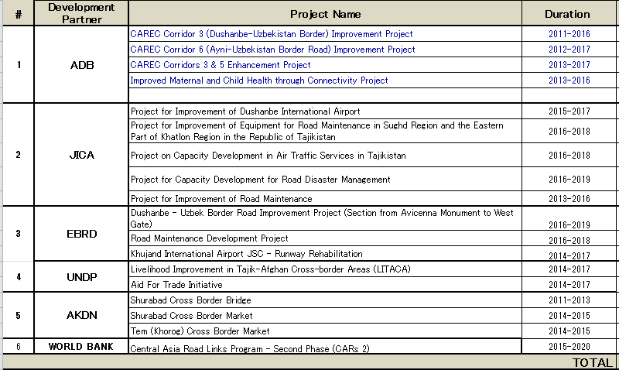
Development Partners’ interventions / Donor’s support
What Development Partners (DPs) active in the specific sector are already doing to support this priorities and remain the priority for the sector (use the matrix of actions that was requested to be updated in our previous GM meetings);

Slide 3
What is missing? But is important for the sector development
(these issues are not necessarily missing, but could be more highlited)
Road/Bridge Disaster Management
Capacity Development of Government Engineers (associated with equipment provision and pilot projects)
Appropriate Budget Appropriation (for (Preventive) Maintenance and (Preventive) Disaster Risk Management)
Establishment of National Standards (Construction, Inspection, Maintenance, etc.)
Further Private Sector Involvement
Enhancement of Road Safety

Slide 4
Priority areas / Results to be achieved by 2020
What are the expected results/outcomes achievable by 2020 in the sector
Road Network enhanced Rehabilitated Bridges and Tunnels Enhanced logistics network/Increased movement of goods and passengers (contributing to enhancement of investment climate and job creation) PPP Project identified Increased awareness of road safety

