Slide 1

Implementing the 2030 Agenda in Tajikistan: SDG Rapid Integrated Policy Assessment
Elena Danilova-Cross
UNDP Istanbul Regional Hub
Development Coordination Council Retreat
preparation guidance for Cluster and Working Group Leads
Dushanbe, 21 November 2016

Slide 2

A ROADMAP TOWARD SDG IMPLEMENTATION
I. Alignment: Assessing national priorities and the SDGs
III. From planning to action: Prioritizing SDG accelerators
II. Data, monitoring, and reporting
V. Resources and partnerships
IV. Integrating into budget frameworks
Notes:
No formula for SDG localization
But some key elements have been identified
These are not linear steps and many can be done simultaneously
All elements are also driven by a multi-stakeholder process to help ensure full ownership

Slide 3

ALIGNMENT: MAINSTREAMING THE SDGs
  Coherence of national plan and SDGs?
  Coherence of sector and sub-national plans?
  Institutional arrangements: cross-sector coordination mechanisms?
Rapid Integrated Assessment: mapping of SDGs against national/sub-national priorities
Ensure appropriate institutional ownership
Learn from the ‘forgotten’ MDGs
RIA reviews the current national development plans and relevant sector strategies, and provides an indicative overview of the level of alignment with the SDG targets
It also identifies inter-linkages across targets
The tool has been used in approximately 10 countries globally
Notes:
Rapid Integrated Assessment: mapping of SDGs (goals and targets) against national/sub-national priorities to determine the readiness of a country to embark on SDG implementation
Ensure appropriate institutional ownership
Balancing between sectoral and cross-sectoral actions
Setting up an institution responsible for inter-ministerial coordination
Learn from the ‘forgotten’ MDGs (those goals/targets that were the least mainstreamed into national or local development strategies/plans

Slide 4
I. Alignment: Assessing national priorities and SDGs
Tajikistan – RIA Methodology
UNDP conducted an integrated assessment of 2 State and 8 sectoral programmes against the SDG targets
Maps SDG targets (rather than goals): Identified 111 targets relevant to Tajikistan (66% of global 169 targets)
Policy areas/sectors covered water, gender, environment, agriculture, health, justice, labour market
Notes:
The objective of the assessment:
Gap analysis of the SDG targets not prioritized
Identify SDG targets that have been prioritized by multiple sectors
Identify sectors where actions can impact multiple SDGs

Slide 5
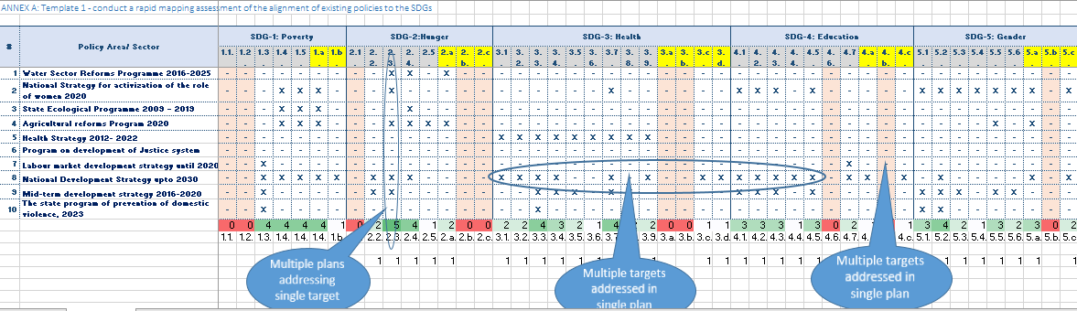
Multi-sector SDG targets

Slide 6


NDS 2030 – alignment with SDGs
INTRODUCTION
SDG 5 (gender)
SDG 11 (cities)
SDG 13 (climate change)
SDG 15 (land)
CHAPTER 3: INSTUTIONAL POTENTIAL
SDG 17 (partnership)
SDG 10 (inequalities)
CHAPTER 4: HUMAN CAPITAL
SDG 4 (education); SDG 3 (health); SDG 1 (well-being); SDG 16 (inclusive societies); SDG 6 ( Water); Goal 5 (gender); Goal 10 (inequalities); Goal 7 (energy); SDG 9 (Infrastructure)
CHAPTER 1 : Tajikistan in 2030
SDG 9 (infrastructure )
SDG 17 (partnerships)
CHAPTER 5: GROWTH AND REAL SECTOR
SDG 9 (infrastructure); SDG 8 (jobs and growth); SDG 17 (partnerships); SDG 1 (well-being); SDG 16 (inclusive societies); SDG 15 (Lands); SDG 4 (education)
CHAPTER 6: M&E
SDG 17 (partnerships)
CHAPTER 2: CHALLENGES AND OPPORTUNITIES
SDG 3 (health); SDG 8 (jobs and growth); SDG 11 (cities)
Notes:
For discussion and this slide will be revised and translated into English

Slide 7

Summary of Tajikistan mapping
3-level of alignment of the SDG targets
111 SDG targets prioritized out of global 169 (68%)
Notes:
High level of alignment is observed in targets including emphasis on SDG 3 (health – 85%), SDG 5 (gender - 89%) , SDG 1 (well-being- 71%), SDG 8 (Growth and Jobs – 83%), SDG 9 (infrastructure and industrialization - 100% ); SDG 6 (Water – 100%); SDG 13 (climate change – 60%); SDG 15 (lands – 58%); SDG 17 (partnerships – 58%);
Medium level of alignment is observed in the priority areas of SDG 4 (education – 80%), SDG 16 (inclusive societies – 50%), SDG 10 (inequality – 50%), SDG 11 (cities – 40%);
Least level of alignment is observed in SDG 14 (oceans – 0%); SDG 12 (consumption and production – 27%)
“Means of implementation” are completely or partially missed for priorities in SDG 8 (growth and jobs); SDG 10 (inequality); SDG 12 (consumption and production); SDG 13 (Climate Change); SDG 16 (inclusive societies)

Slide 8
From MDGs to Agenda 2030 in Tajikistan
National MDGs (2000-2015) | Global SDGs (2016-2030)
MDG 1. Poverty and hunger (4 indicators) | SDG 1. Poverty (7 targets) SDG 2. Hunger and food security (8 targets) SDG 8. Growth and jobs (12 targets) SDG 10. Inequality (10 targets)
MDG 2. Education (3 indicators) | SDG 4. Education (10 targets)
MDG 3. Gender (3 indicators) | SDG 5. Gender (9 targets)
MDG 4. Child mortality (3 indicators) MDG 5. Maternal health (2 indicators) MDG 6. HIV/AIDS, malaria, other diseases (7 ind) | SDG 3. Health (13 targets)
MDG 7. Environmental sustainability (5 indicators) | SDG 6. Water (8 targets) SDG 7. Energy (5 targets) SDG 9. Infrastructure and industrialization (8 targets) SDG 11. Cities (10 targets) SDG 12. Sustainable consumption and production (11 targets) SDG 13. Climate change (5 targets) SDG 14. Oceans (10 targets) SDG 15. Lands (12 targets)
MDG 8. Global partnership (5 indicators) | SDG 17. Partnerships (19 targets)
 | SDG 16. Peaceful and inclusive societies (12 targets)
Notes:
Green = nationally reported as achieved; Blue – nationally reported as achieved; Yellow = terra incognita

Slide 9
Within SDG gap analysis (Tajikistan)
SDG “means of implementation”: many targets not covered but often not relevant for ‘development plans’ but further attention to “means of implementation’ targets can drive SDG progress (SDG 8 (growth and jobs); SDG 10 (inequality); SDG 12 (consumption and production); SDG 13 (Climate Change); SDG 16 (inclusive societies)
SDG 11 (Cities): Low coverage of 11.3 (sustainable urbanization), 11.6 ( environmental impact of cities), 11.7 (green and public spaces)
SDG 12 (Growth and jobs): Gaps in 12.1 (frameworks and programmes on sustainable consumption and production), 12.3 (food losses), 12.6 (sustainability reporting), 12.7 (sustainable public procurement) . 12.8 (sustainable lifestyle)
SDG 16 (inclusive societies and democratic governance): Gaps in 16.1. (reducing all forms of violence) 16.2 (abuse of children), 16.4 (combating organized crime), 16.9 (legal identity), 16.10 (public access to information)as well as lack of inclusive decision-making including local governance
SDG 14 on oceans seems to be irrelevant

Slide 10
Cross-sectoral gap analysis (Tajikistan)
Sectoral strategies with well-address cross-sectoral nature of SDGs
Water Programme up to 2025 covers SDG 6 on water, SDG 1 on well being, SDG 7 on Energy, SDG 9 on infrastructure, SDG 16 on inclusive societies and SDG 17 on partnerships
State Ecological program up to 2019 covers SDG 6 on water, SDG 7 on Energy, SDG 1 on poverty, SDG 2 on hunger, SDG 15 on lands, SDG 13 on climate change, SDG 12 on SCP and SDG 11 on cities
Agricultural Reforms program up to 2020 is the most cross-sectoral of all: it is present in SDGs 1,2,5,6,8,12 and 13
Labour Market development strategy up to 2020 is a matter of concern it terms of having rather limited cross-sectoral presence ( only in SDGs 1,3,8 and 10), while this sector is an “enabler” or accelerator for lifting up many other SDGs
Sector-specific strategies that are working in silos
Health up to 2022 is only covering SDG 3 on health
Domestic Violence up to 2023 is mostly targeting SDG 5 on gender and is also represented in SDG 1 (well-being) and SDG 3 (health)

Slide 11
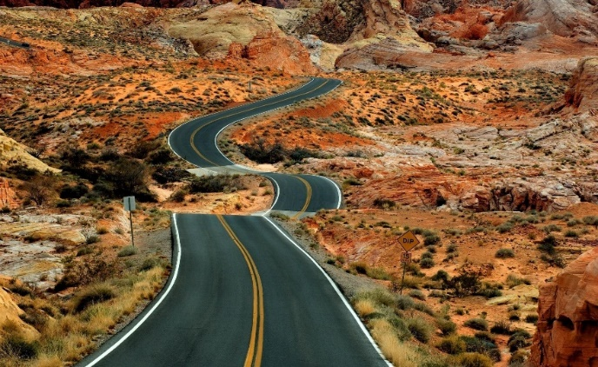
Taking the assessment forward:
Policy implementation - KAZ
Putting in place a policy framework that supports SDG achievement is a critical step
Policies as effective as their implementation
Consider the nature of the gaps and their relevance in Kazakhstan’s context; based on this, determine nationally appropriate targets
Whole of government approach to attaining SDGs—Minister-level cabinet member or dedicated team in charge of coordinated implementation
SDG Dashboard populated with timely, policy-relevant data to facilitate aligning plans with targets; making choices on actions; and adapting policies for anticipated constraints: technological change; globalization; urbanization; demographic shifts; and for aggregate limits on development paths.
Policy reforms to set incentives right for private sector to drive sustainable human development forward, e.g., carbon pricing that reflects global social/environmental costs
Seize synergies from aligning national implementation with international context—SDG 17.

Slide 12

Taking the assessment forward:
ACCELERATION and Synergies - KAZ
Identify enabling activities that accelerate progress across a range of SDGs
Cross-sectoral solutions and data to support analysis
Look beyond direct, linear, isolated effects: (i) SDGs, countries & regions interact; (ii) externalities, public goods, returns to scale can lead to market failures; (3) feedback loops set in motion can have large cumulative effects, shaping development path & requiring reoptimization
Improved institutional arrangements will help achieve Goal 16 and help create favorable conditions for achieving targets of many other Goals
Prioritizing the integration of Goal 5 targets on gender equality and women’s empowerment addresses multiple economic and social goals
Emphasis on transition to green economy, energy efficiency, water management in development planning

Slide 13
Source of NDS 2030 financing
Total cost estimate
118.1 bln USD (in 2014 prices)

Slide 14
Source of NDS 2016 - 2020 financing
Total cost estimate
over 25.5 bln USD (in 2014 prices)

Slide 15
What could be the role of development partners?
Coordination:
Azerbaijan: inter-agency and inter-governmental SDG Taskforce to develop an SDG roadmap.
Groups are designed at 2 levels (ministerial level + technical level)
Each group has representative from UNCT and relevant dev partner
Each group has an NSO representative
Sharing responsibilities:
Georgia. Together with the UN and other development partners, Georgia is creating a digital/online platform for interactive data collection and visualization of the SDGs and nationalization process.
National SDG Reporting
Montenegro. High Level Political Forum voluntary review 2016:
human resources and strengthening social inclusion;
social resources (support to values, norms and behavior patterns) + Rule of Law and trust to institutions;
natural resources (natural capital, introduction of green economy)
governance for sustainable development
financing for sustainable development.
NP 1
NP2
NP3
NP4
NP5

Slide 16
UNDP’s contribution to SDGs in Tajikistan
SDGs are nationally adapted and operationalized
Monitoring and reporting aligned with SDGs
The process of elaboration, implementation and M&E, and their alignment with NDS/MTDP improved
Promotion of SDGs’ implementation
Capacities of the National Development Council and MEDT supported
Public awareness to promote multi-stakeholder dialogue strengthened
Notes:
Output 1. Prioritized SDGs are nationally adapted and included into national monitoring frameworks
- Activity Result 1: Monitoring and reporting system of the national strategies aligned with SDGs
Activity Result 2: Improve the process of elaboration, implementation and M&E of the sub-national level development programmes and their alignment with NDS/MTDP/SDGs
Activity Result 3: Strengthening reporting system for sub-national, national and sectoral strategies linked to the prioritised SDGs
Output 2. Promotion of the Sustainable Development Agenda 2030 to operationalize SDG implementation and strengthen public awareness and citizens engagement
- Activity Result 1: Support capacities of the National Development Council and MEDT as coordinating agency to plan, review and report on SDGs implementation
-Activity Result 2: Strengthening public awareness to promote multi-stakeholder dialogue on Agenda 2030 – SDGs, NDS/MTDP

Slide 17
Thank you very much!
Questions for discussions? elena.danilova-cross@undp.org

Slide 18





SDG COUNTRY REPORTING GUIDELINES: OUTLINE
CHAPTER 1
CHAPTER 2
CHAPTER 3
CHAPTER 4
Introduction
Setting the scene for reporting
Follow up and review processes:
global (HLPF)
regional (SDG Regional Reports)
country (SDG Country Reports)
Principles
Universality
leaving no one behind
integrated agenda and indivisible
human rights
National ownership
Drivers of an inclusive process
Who and How to engage?
Identifying relevant stakeholders
Setting up platforms for engagement
Leveraging IT technology

Slide 19


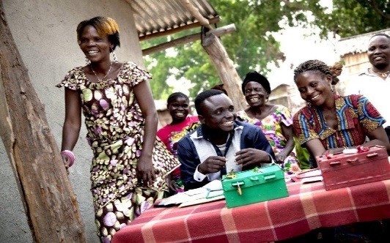
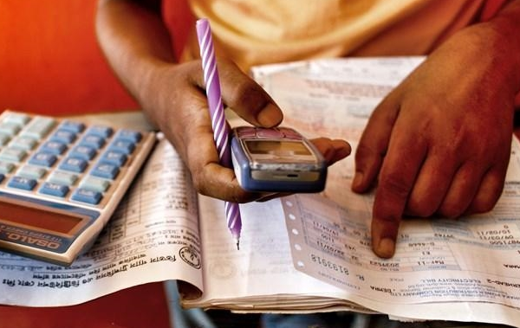
SDG COUNTRY REPORTING GUIDELINES: OUTLINE
CHAPTER 5
CHAPTER 6
CHAPTER 7
Localizing SDG targets
Defining national SDG indicators (based on the global framework)
Setting baselines
Preparing an analytical report
Methodologies:
  Analytical narratives
  MAF
  Trend analysis
  Focus groups
  Microsimulation
  Growth dynamic
  Systems and economy wide modelling
Communications, dissemination and advocacy
Developing an advocacy plan
Reaching target audiences
Annex: Suggested outline for a SDG Country report

