Slide 1
AGA KHAN AGENCY FOR HABITAT
Building Climate Change Resilience in Central Asia

Slide 2
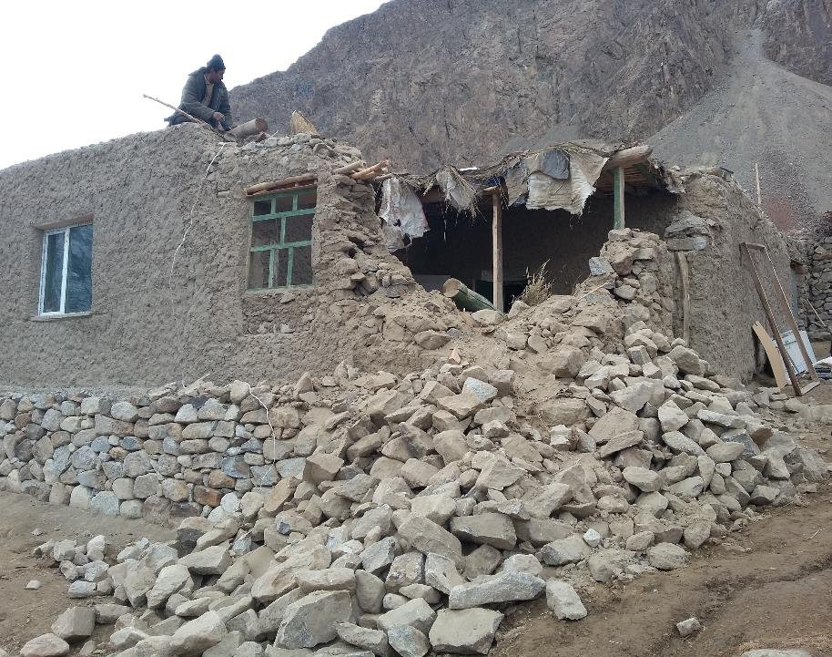
Context in Tajikistan
Nearly 93 per cent of Tajikistan’s land mass is mountains, with glaciers making up 6 per cent
Over 73 percent of the population (6 million people) live in rural areas (World Factbook, 2016) and are the primary victims of natural disasters caused by climate change
Currently 85 percent of Tajikistan’s area is threatened by mudflow
Between 1993 and 2015 as a result of natural disasters:
498 individuals lost their lives;
9,611,393 million people had their homes and assets destroyed.
(source: World Disaster Report 2016)

Slide 3
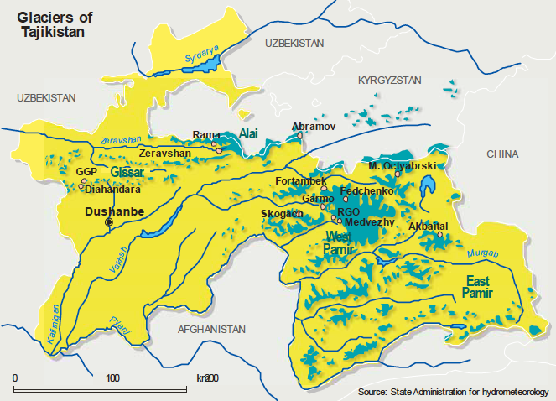

Slide 4
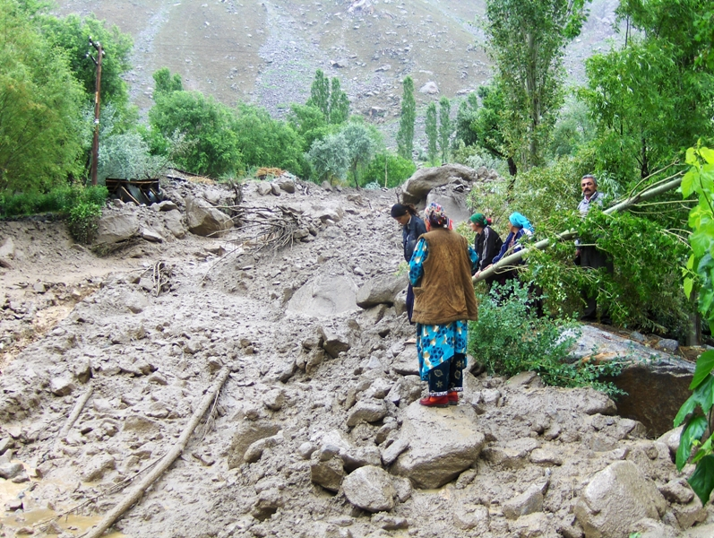
Macroeconomic Impact
Between 1997-2014:
Damage caused by natural disasters cost Tajikistan over $500 million USD;
Climate induced disasters (mudflow and droughts) were responsible for the highest monetary losses, causing damages valued at 20.4 million USD per year.
(source: Draft Natural Disaster Risk Management Strategy for Tajikistan, May 2016)
The adverse impact of natural disasters in Tajikistan per annum is equivalent to almost 5 percent of GDP
(source: World Bank Report on Climate Change Adaptation in Tajikistan)

Slide 5
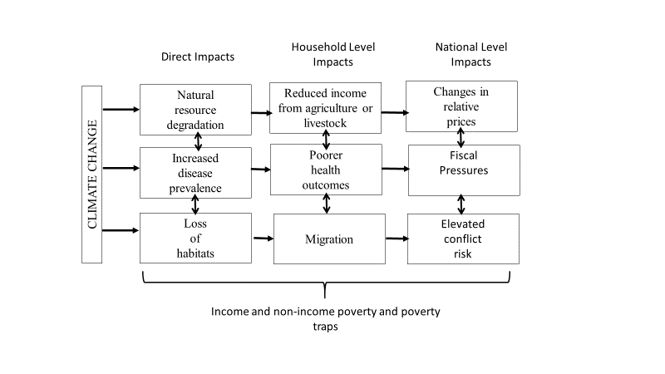
Macroeconomic Impact
Impact of Climate Change from household to national level
Impact of Natural Disasters and Return on Investment
The mid term National Development Strategy for the Government of Tajikistan recognizes that as a result of climate the frequency of natural disasters is increasing (source: Draft NDS 2016-2030)
Women and Children are the most vulnerable to the effects of natural disasters
Investing in disaster risk reduction (DRR), preparedness and mitigation saves lives and provides a high return on the initial investment
Community based DRR projects in particular have proved cost effective in Tajikistan (source: World Disaster Report 2016)
source: World Bank Report on Climate Change Adaptation in Tajikistan

Slide 6
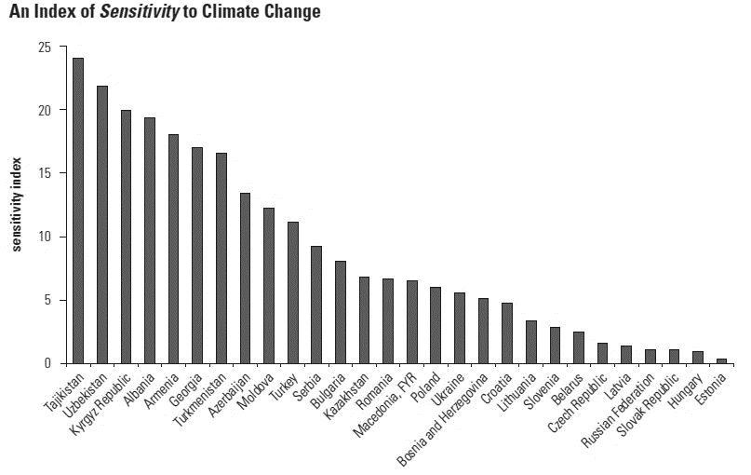
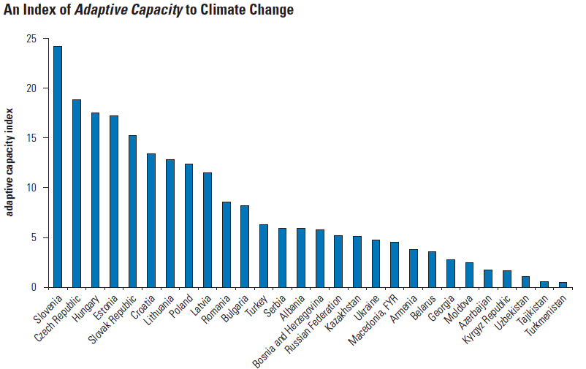
Tajikistan’s Vulnerability to Climate Change
Index of Vulnerability and Adaptive Capacity Across Europe and Central Asian Countries
source: World Bank Report 2010

Slide 7
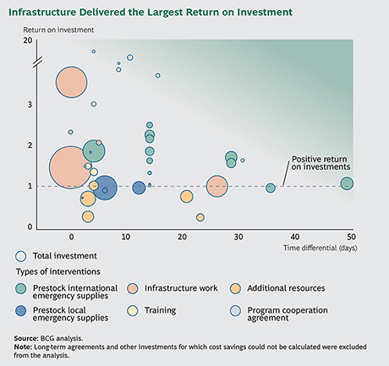
Preparedness – Return on Investment (BCG)
Large infrastructure investments yield the highest absolute savings.
Training yields the highest ROI owing to its relatively small initial investment. But to fully capture the value, the trained staff must be retained to share knowledge and ensure quality.
The more dependent a country is on external goods and services, the higher the return on any investment that ensures their availability in an emergency.
In countries with higher coping capacities, the ROI for more basic emergency preparation fades, and the value shifts to training and improving organizational capacity.
source: BCG / WFP / UNICEF June 2015

Slide 8
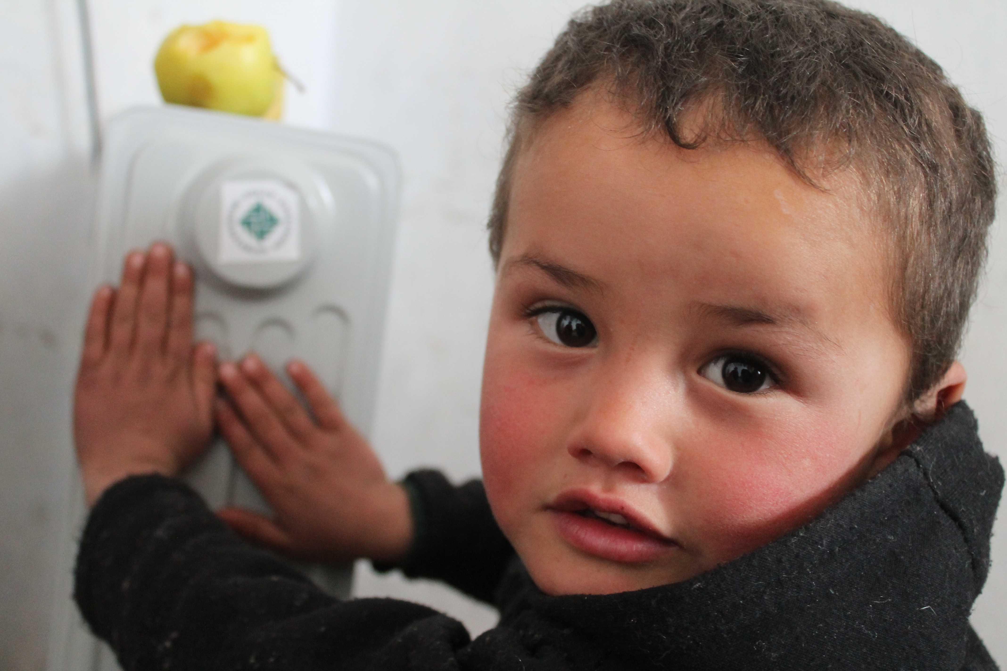
Recommendations
Understand the risk posed by climate change at a community level a regional and national level and developing an integrated risk management approach methodology
Build Community Capacity to address their specific and local risks from a changing climate
Developing an integrated emergency response platform and mechanism with the government, community emergency responders and the international community to respond in a coordinated manner
Joint Government, Donor and Civil Society engagement in meeting commitments to international agreements for Tajikistan
Engaging the market in climate change resilience building through public-private sector initiatives and enterprise development

Slide 9
BUILDING CLIMATE CHANGE RESILIENCE IN TAJIKISTAN
Enhanced Quality
of Life
Enabling & Resilient Habitat
Lives Saved
Enhanced Resilience
Decreased Poverty
Capacity to Respond to Emergencies
Capacity to Plan for Emergencies
Capacity to Deliver Habitat / Environment Enhancement Solutions
Enhanced AKDN Capacity to address climate change triggered events
Enhanced Community Capacity to adapt to climate change
Enhanced Civil Society Capacity to support Communities and Government
Enhanced Government Capacity to prepare for and respond to climate change

Slide 10
AKAH Climate Change Framework and Interventions
Climate Change
Socially Enabling
Economically Enabling
An enabling and resilient habitat
Natural Hazard Resilience
Climate Change Adaptation
Increasing Temperatures across Central Asia
Responding to climate change
Protecting communities in their Habitats
Land Use & Development Planning
Supporting Transition to areas of Resilience
Increasing hydrological, meteorological and geological disasters
Emergency Response
Disaster Preparedness
Enabling Housing
Habitat Improvement
Increasing Snow Caps melting leading to larger glacial lakes
Community Emergency Response Teams
Search & Rescue Teams
Disaster Assessment Teams
Avalanche Preparedness Teams
AKDN Safety Officers
Emergency Operation Centers
Partnerships and Scenario Planning
Emergency Communications
Prepositioned Stockpiles
Hazard Vulnerability and Risk Assessments
Emergency Shelters / Safe Havens
Community Response Capacity Building
Institutional Response Capacity Building
Weather Monitoring & Early Warning Systems
Relocation and Resettlement
Building Enhancements for resilient and enabling homes
Financing models for Housing access
Risk Insurance models
Technical Advisory services
Structural Mitigation of Hazard Risks
Resilient & Enabling Infrastructure
Resilient & Enabling Buildings
Artisan & Builders Capacity Building
Environmental Protection Measures
Habitat Enabling Enterprise Development
Increasing number of natural hazards
Increasing severity of natural hazards
Increasing loss of life and property
Decreased ability to engage in development
Reduced Quality of Life
Reduced Resilience
Knowledge Management and Operational Research

Slide 11
BUILDING CLIMATE CHANGE RESILIENCE IN TAJIKISTAN - Policy
National Engagement
Mid Term Draft National Development Programme for Tajikistan 2016-2020:
Disaster risk management and climate change mitigation are cross cutting priorities;
Tackling impact of natural disasters (prevention/resource management) is a priority for the Government of Tajikistan (GoT) .
Mainstreaming Climate Change into Strategic Documents
Engagement in the development of the National Disaster Risk Management Strategy 2016- 2030 for the GoT – currently draft
Creation of a unified systems for disaster response
Climate change – improved damage assessment, improved preparedness (national and local), updating Tajikistan’s EWS, linking data to risk assessments, public education.
Improved recovery planning and coordination (fire service, volunteers, etc)
Supporting the Government of Tajikistan fulfil its commitments as a signatory to the Kyoto protocol and the 3rd National Communications on Climate Change produced under the UN Framework Convention on Climate Change
Tajikistan participated in COP21 in Paris and COP 22 in Marrakech
Enhancing EWS and new approaches to climate change adaptation for mudflows heat waves and drought.
DRR Policy
Engaging with the Sendai Framework for Disaster Risk Reduction 2015-2030
Understanding Disaster Risk, Strengthening Disaster Risk Governance, Investing in DRR for Resilience, Enhancing Disaster Preparedness for response.
Engaging with the Government of Tajikistan achieve Goals 11 and 13 of the Sustainable Development Goals, (Building Sustainable Cities and Communities and Combating Climate change and climate action)
Notes:
Development of the National Disaster Risk Strategy development supported by UNDP, should be developed by end of the year. Last National Action Plan on Climate change by the gov was made in 2003, could be potential to work with gov to create a new national action plan.

Slide 12
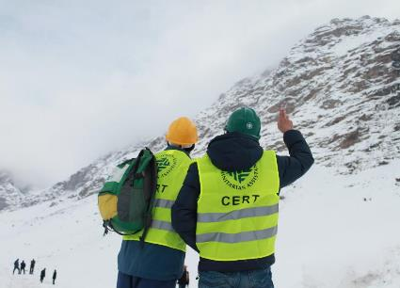
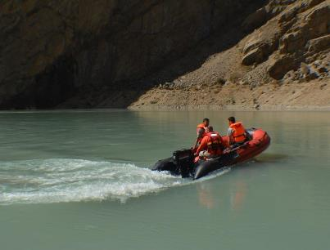
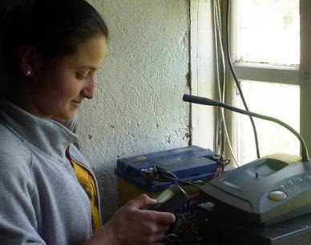
AKAH: BUILDING CLIMATE CHANGE RESILIENCE IN TAJIKISTAN
Community Emergency Response Teams
First responders to natural disasters caused by climate change
Trained in First Aid, Search and Rescue, including training to INSARAG standard for some volunteers
AKAH Tajikistan has trained over 2,000 CERTs members across GBAO, half are female
Search and Rescue Teams
Two professionally trained Search and Rescue Teams (SART), 20 members each
Urban SART in Khorog town, rural in Rushan district
Composed of CERTs, Fire Department staff, members of the Committee of Emergency Services of Tajikistan, received INSARAG training
Emergency Communications Equipment
During natural disasters conventional means of communication such as GSM often do not work
AKAH has installed 90 CODAN units in the most disaster prone areas of GBAO
During Bartang earthquake- CODAN radios served as only means of communication
Notes:
Development of the National Disaster Risk Strategy development supported by UNDP, should be developed by end of the year. Last National Action Plan on Climate change by the gov was made in 2003, could be potential to work with gov to create a new national action plan.

Slide 13
AKAH: BUILDING CLIMATE CHANGE RESILIENCE IN TAJIKISTAN
Community Emergency Response Teams
First responders to natural disasters caused by climate change
Trained in First Aid, Search and Rescue, including training to INSARAG standard for some volunteers
AKAH Tajikistan has trained over 2,000 CERTs members across GBAO, half are female
Search and Rescue Teams
Two professionally trained Search and Rescue Teams (SART), 20 members each
Urban SART in Khorog town, rural in Rushan district
Composed of CERTs, Fire Department staff, members of the Committee of Emergency Services of Tajikistan, received INSARAG training
Emergency Communications Equipment
During natural disasters conventional means of communication such as GSM often do not work
AKAH has installed 90 CODAN units in the most disaster prone areas of GBAO
During Bartang earthquake- CODAN radios served as only means of communication
Notes:
Development of the National Disaster Risk Strategy development supported by UNDP, should be developed by end of the year. Last National Action Plan on Climate change by the gov was made in 2003, could be potential to work with gov to create a new national action plan.

Slide 14
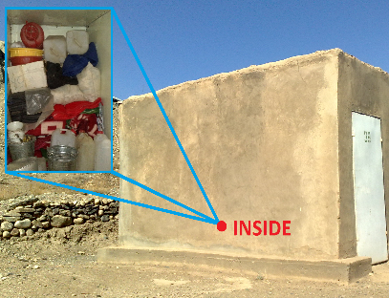
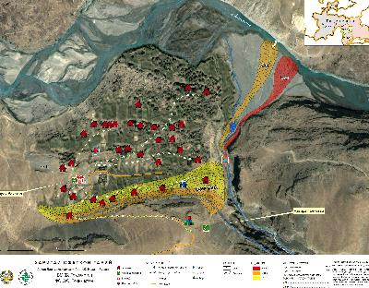
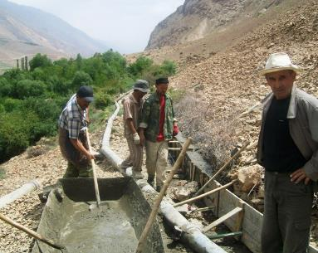
AKAH: BUILDING CLIMATE CHANGE RESILIENCE IN TAJIKISTAN
Stockpiles
To prepare for natural disasters caused by climate change AKAH has stockpiles to meet the needs of 350 families or 2,000 individuals
Stockpiles contain NFIs to meet the basic survival needs of families in the immediate aftermath of a disaster
Hazard Vulnerability Assessments
AKAH has carried out over 360 HVRAs in villages across GBAO and in 50 villages in Rasht valley
Conducted two urban HVRAs, in Khujand and Dushanbe
Working closely with government to ensure the HVRAs translated into land use planning
Structural Mitigation Projects
AKAH has implemented over 350 structural mitigation projects across GBAO
Included flood protection measures, river bank reinforcement, debris flow channels
Mitigation projects are implemented in consultation with the government and local community and owned by community and local government
Notes:
Development of the National Disaster Risk Strategy development supported by UNDP, should be developed by end of the year. Last National Action Plan on Climate change by the gov was made in 2003, could be potential to work with gov to create a new national action plan.

Slide 15
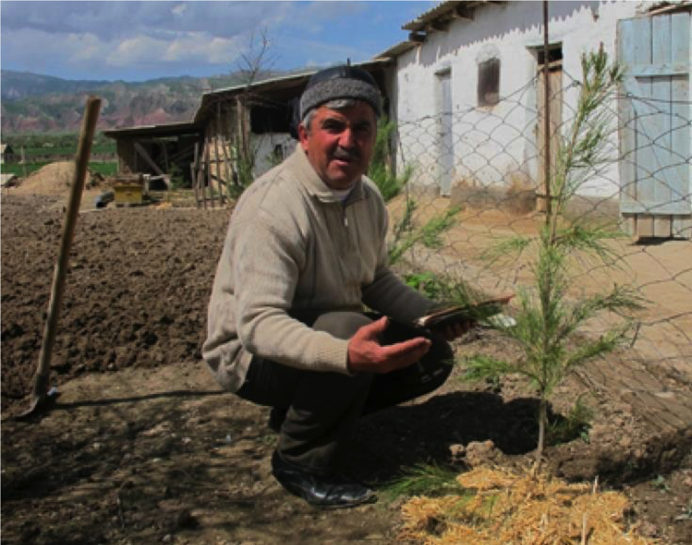
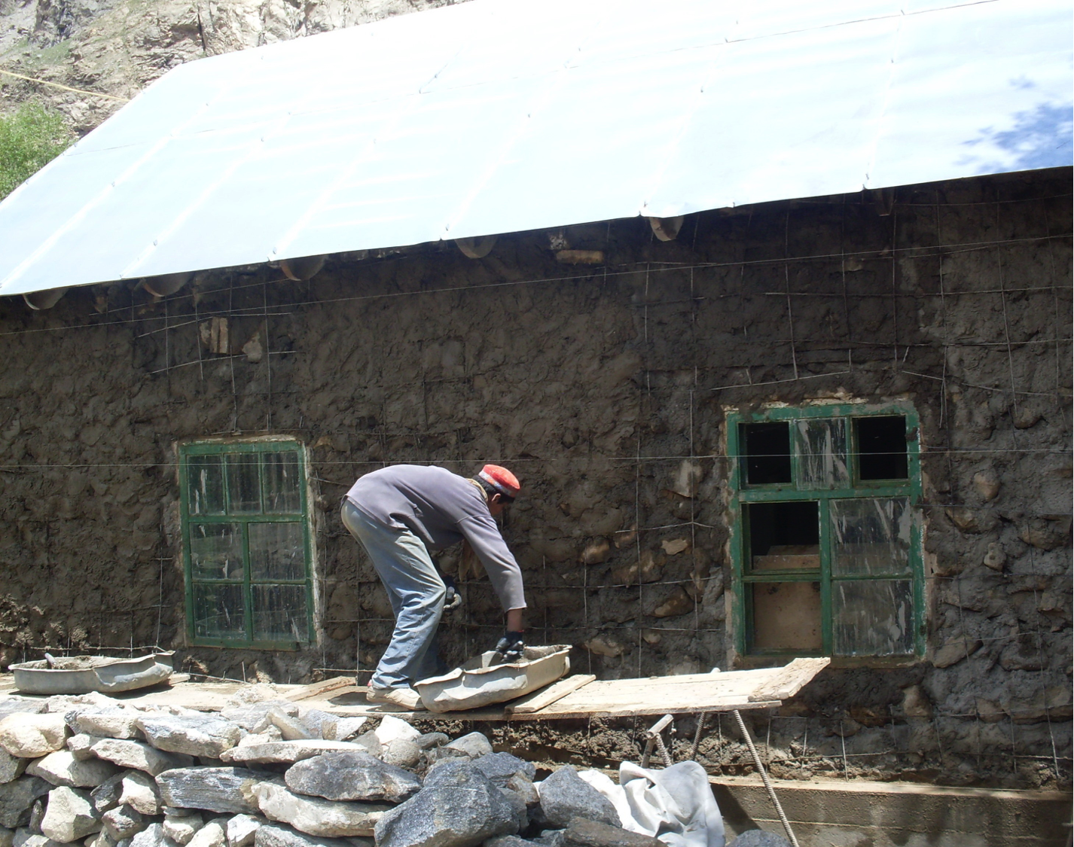
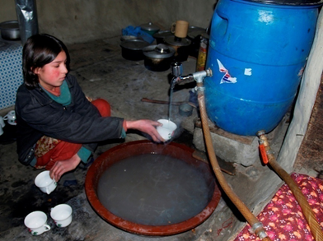
AKAH: BUILDING CLIMATE CHANGE RESILIENCE IN TAJIKISTAN (FOCUS/MSDSP)
Environmental Protection Measures
Tree planting projects to prevent soil erosion and land degradation
Training for farmers on livelihood enhancement through technology of forestry development, conservation and management of current forest reserves
Resilient Building
Seismic retrofitting of public and private buildings
Capacity building and awareness raising campaign on safe and resilient construction
Fuel Efficient Cookstoves
Development of fuel efficient cooking stoves which reduce smoke in the house and are more environmentally friendly
Environmental protection measures and improved health indicators
Notes:
-FOCUS helped retrofit 2 public facilities and 2 private houses and trained 24 local masons and builders in seismically safer construction techniques (DIPECHO 7).
-Through School Safety Initiative Project, FOCUS implemented seismic structural retrofitting, non-structural mitigation, and earthquake risk awareness and preparedness in 12 pilot schools in GBAO
-Currently FOCUS producing an education video on safe and resilient construction (DIPECHO 9).

